Slide 1

Welcome to
Roberts Middle School
Incoming 6th Grade
Parent Night
Welcome Future Chargers!

Slide 2
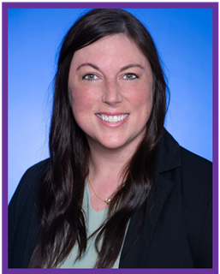
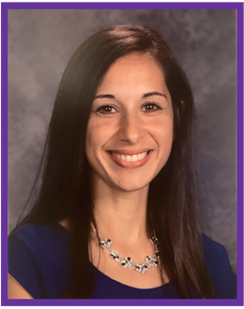
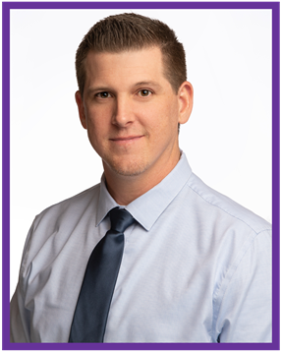
RMS Administration Team
Principal:
Kyle Little
klittle@lcisd.org
Assistant Principal (A-L)
Courtney Barrera​
Courtney.barrera@lcisd.org
Assistant Principal (M-Z)
Monica Flores​
moflores@lcisd.org

Slide 3
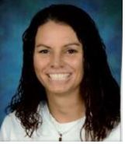
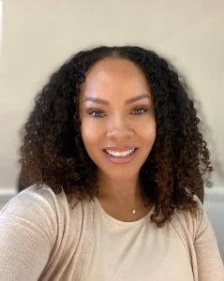
RMS Counseling Team
Wendy Reed
Alpha Split A- L
Wendy.reed@lcisd.org
Simona Smith
Alpha Split M- Z
Simona.smith@lcisd.org

Slide 4
Elementary vs. Middle School
Elementary
1-3 teachers
Class length 30 Minutes-2 hours
Travel in groups with teacher
Recess
Few choices at lunch
Fine arts during specials
Middle School
7 teachers
Class length is 60 minutes
Travel independently
PE everyday
More choices at lunch
Fine arts elective class

Slide 5
Roberts Middle School General Information
School Hours- 9:05-4:30
Doors open at 8:35
60 minute class periods
4- minute passing period

Slide 6

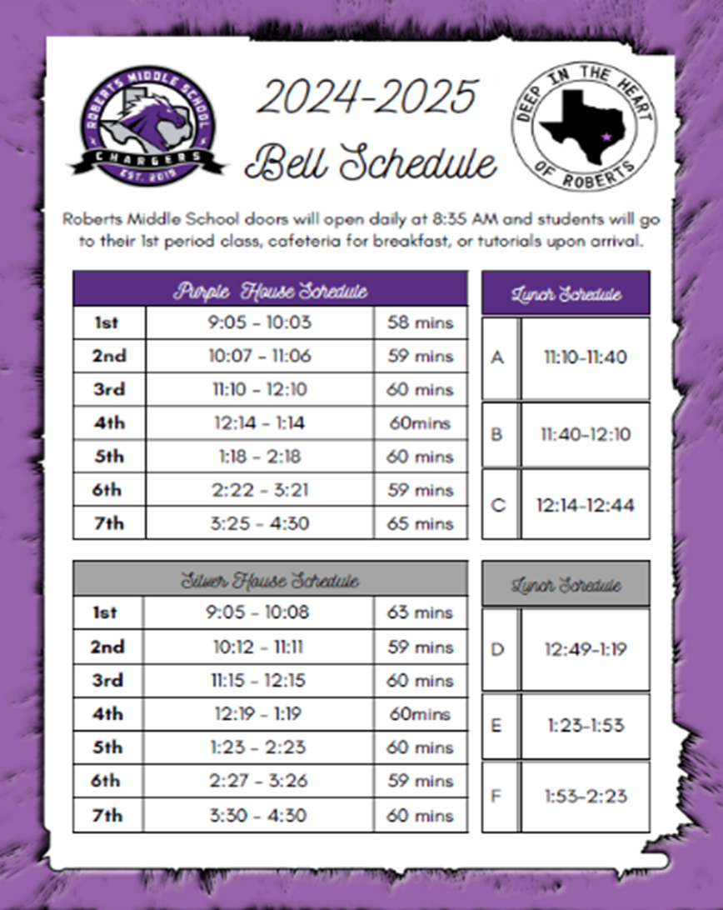
Two Houses One School: Purple & Silver

Slide 7

6th Grade Daily Schedule
ELAR
Math
Science
Social Studies
PE or Dance
Elective - full year (Choir, Band, Orchestra, Theatre, or Art)
Charger Win- Dedicated Intervention and Extension. Will change throughout the year.

Slide 8
Course Levels: Academic vs. Pre AP / GT
Academic
Academic courses in middle school are ON grade level.
Academic courses in middle school cover the same information that Pre AP courses do.
PAP/GT
Content is more in depth.
Assignments are higher level thinking / more challenging.
We encourage families to consult the 5th grade teacher, reference STAAR scores(Meets or Above), and reflect on nine weeks averages from 5th grade.

Slide 9
Full Year Elective Options
BAND- Brass, Percussion, Woodwinds
ORCHESTRA- Violin, Viola, Cello, Bass
CHOIR- Singing and Performing
THEATER- Acting, Auditions, History, Directing, Stage Directions, Playwriting, and Tech
ART- Sculpting, Drawing, and Painting

Slide 10
Physical Education is a required daily class.
6th graders attend PE every day.
Students are graded based on their ability to participate every day.

Slide 11
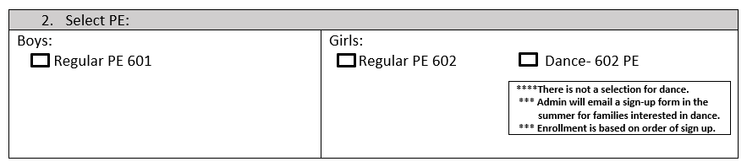

Dance(Girls PE option)
Dance is offered as an alternative to PE for girls only.
If interested, mark Dance on the course selection sheet.
Once the course selection process is over, a sign up will be sent out through email to parents.
Dance sections will be filled on a first come, first served based on the sign-up form.

Slide 12
Off Campus PE
Applications / qualifications can be found LCISD website - Athletics Department.
Click here to access the Off Campus PE application.
Deadline to turn application – First day of School.
Students report to the front office at the start of 7th period. They may be picked up at that time.
This counts as their PE credit.
A grade reporting form, completed by the coach, must be turned into the counselor at the end of each 6 week.

Slide 13

Course Selection
Course selections will be open in Skyward on Monday 2/3 and continue through Friday 2/7.
RMS counselors will visit every elementary campus to present to students on course offerings next week.
During the 5th grade visit, students will receive a course selection sheet that the counselor will go over with them.

Slide 14

Course Selection Continued
For required courses you will select one of each
    English Language Arts / Reading (ELAR)
    Math
    Science
    Social Studies
    PE course
  For Electives – students will list in order of preference(1st - 4th).
    The top choice in electives is NOT guaranteed
    Please have students turn their signed course selection form into their counselor by Friday, February 7th.
This Photo by Unknown author is licensed under CC BY-SA.

Slide 15
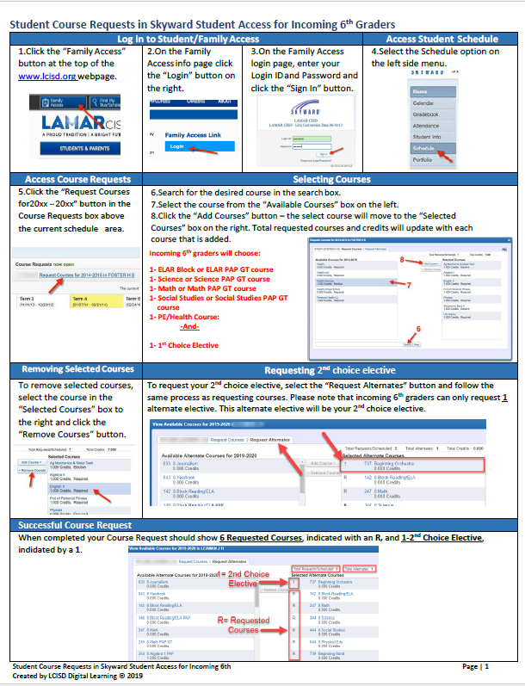
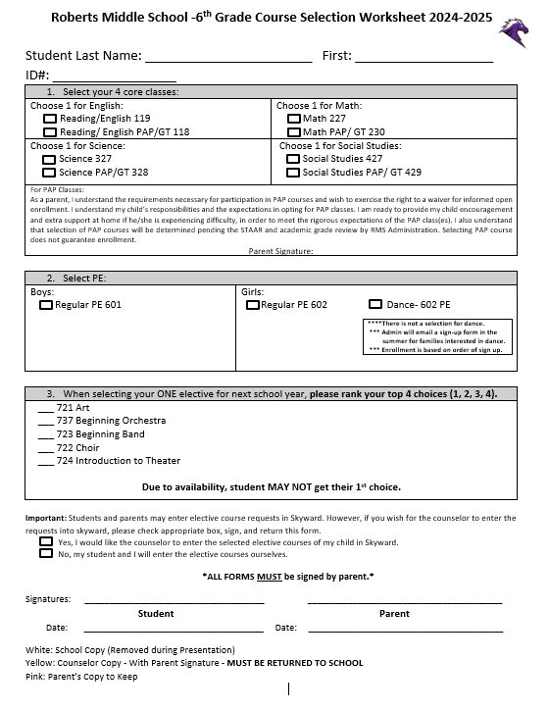
IMPORTANT FORMS TO LOOK OUT FOR
Entering Courses into Skyward
Student Course Selection Sheet

Slide 16

Welcome to CHARGER NATION!!!

