Slide 1
Dual Credit
Kimmy Ethridge
Dual Credit Counselor
GRHS

Slide 2
What is Dual Credit?
A system in which an eligible high school student enrolls in college course(s) and receives credit for the course(s) from both the college and high school.
Dual Credit courses in LCISD are generally taught by a LCISD teacher who is also employed by Lone Star College. There may be times when the course is taught by an ONLINE LSC professor and monitored by a LCISD teacher [the course is on the student’s schedule, the college class is online, the HS teacher helps facilitate the online course and maintains the high school gradebook].

Slide 3
What is Dual Credit?
Dual credit courses are college classes first and high school classes second. Students and teachers are required to follow all LSC policies, i.e., attendance, grading, academic honesty, etc.

Slide 4
What is the difference between Dual Credit and AP credit?
Advanced Placement (AP) – Allows high school students to participate in an AP course and earn college credit with successful performance on the course AP exam. Postsecondary institutions accept AP exam scores as college credit if the student meets the exam score requirements established by the institution. At a Texas public college or university, an AP exam score of 3 will be awarded credit. The amount of credit and the course for which credit is awarded is determined by the college or university and can be found on their websites.

Slide 5
What are the benefits of Dual Credit?
Student saves on tuition and fees by reducing the time to complete a degree (2024-25 tuition: $129 per 3-hour course)
  Students who are enrolled in the federal free or reduced lunch (FRL) program will not pay tuition for dual credit courses*. Students not eligible/enrolled in the federal FRL program will pay a reduced tuition fee for courses.
    * Financial Aid for Swift Transfer (FAST) Program
Weighted credit on your high school GPA
  LSC dual credit courses receive a 1.3 multiplier for each semester course. (except for College Algebra- MATH 1314, the students receives 1.2 in the fall and 1.3 in the spring).

Slide 6
What are the benefits of Dual Credit?
LSC students will receive college credit and high school credit simultaneously.
Student can graduate from high school with transferable college credits
Students can fast-track their undergraduate or workforce degrees
Students will have access to a full range of college student support services while in high school to aid them in a smooth transition to college after graduation

Slide 7
Other benefits of Dual Credit…
College/University | Cost per 3 SCH Course (not including textbook)
Houston Community College | $547.50
Wharton County Junior College | $483
University of Houston, Main Campus | $1576.58
University of Texas, Austin | $2394
When you factor in room and board, one course can save you as much as $2,000 or more!

Slide 8
How am I eligible for Dual Credit?
Students who meet TSIA2 (Texas Success Initiative Assessment 2.0) or dual credit eligibility requirements may enroll in Lone Star College dual credit courses.
Eligibility can be based on:
  TSIA2- ELAR: 945+ AND Essay 5; OR 910-944, Diag 5-6, AND Essay 5-8
      MATH: 950+ ; OR 910-949 AND Diag 6
  SAT- ELAR EBRW Score: 480 ; MATH Score: 530
  ACT- ELAR Combined English & Writing Score: 40 ; MATH Score: 22
  *NOTE: STAAR and PSAT scores will no longer be used for eligibility

Slide 9
How is Dual Credit Applied at the College?
Students will need to check with the institution they plan to attend for specific policies regarding the transfer of dual credit courses prior to enrolling in any course.
The transferring university will determine if only the course transfers or if the course and the GPA transfers.
Some 4-year institutions will not accept “D’s” in dual credit courses. It is important to work hard for an “A” or “B” in a DC course. LSC gives A, B, C, D, and F.

Slide 10
Dual Credit Registration Process
See your high school dual credit counselor for HS specific DC enrollment processes. (Enrollment will take place Spring 2025)
Student must submit LSC application through Apply Texas by the campus deadline.
Student must meet TSIA2 Readiness Standards by campus deadline.
Students are only able to register for dual credit courses entered on the LSC Dual Credit Waiver Request form and which have been approved by the DC Counselor.
Check with the DC Counselor to make sure you are approved BEFORE starting the course(s).

Slide 11
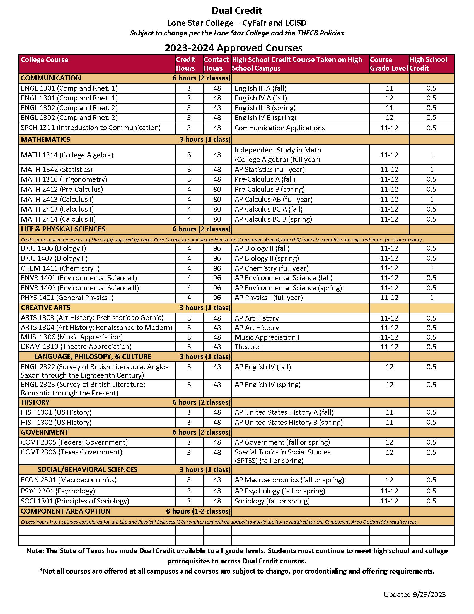
LCISD Approved Dual Credit Courses
2023-2024
Not all dual credit courses are available on all high school campuses.
Dual Credit courses are offered to specific students at specific grade levels.
Not all dual credit courses are available on all high school campuses.
Dual Credit courses are offered to specific students at specific grade levels.

Slide 12
Are you ready to start college?
Dual credit is a wonderful opportunity for all students. We encourage you to speak with parents, teachers, counselors about the benefits of taking a college course while still in high school.
Statistics show that students who enroll in dual credit courses are 10% more likely to complete a Bachelor’s degree than comparison groups.
Why not start college early?

Slide 13
Dual Credit Counselor
Kimmy Ethridge
Kimberly.ethridge@lcisd.org
George Ranch HS

