Slide 1


Slide 2
Important Vocabulary
Endorsements – a related series of courses that are grouped together by interest or skill set. Most students graduate with an endorsement.
Career Clusters – A group of careers that share common themes. There are 14 Texas identified career clusters that are aligned with the five endorsement categories.
Programs of Study – a coordinated, non-duplicative sequence of courses which progress in specificity, beginning with all aspects of industry and leading to more occupation specific instruction.
Notes:
Dual Credit Opportunities
Industry-Based Certifications
CTSOs (i.e., DECA, FFA, HOSA, SkillsUSA, TAFE, TSA)
National Technical Honor Society

Slide 3
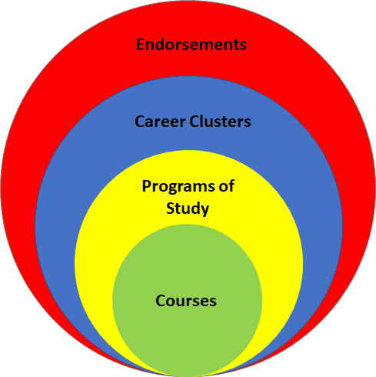
How does that vocab all fit together?
Notes:
Endorsements are part of a student’s graduation plan.

Slide 4
How is the endorsement connected to CTE?
Subjects & Courses Required | Foundation + Endorsement Credits
English English I English II English III Additional English Course | 4
Mathematics Algebra I Geometry Algebra II Additional Math Course | 4
Science Biology 3 Additional Science Courses | 4
Social Studies World History or World Geography U.S. History U.S. Government (.5 credit) Economics (.5 credit) | 3
Physical Education | 1
Languages Other than English Two credits in the same language. | 2
Fine Arts | 1
Electives Classes available for electives will be based upon the endorsement option(s) selected by the student | 7
Total Credits | 26
Notes:
Endorsements are part of a student’s graduation plan.
A student must earn at least 26 credits to earn an endorsement
You can earn an endorsement different ways, which is listed in the course catalog.

Slide 5
In CTE, students can earn endorsements in 3 different areas: Business & Industry, Public Service, or STEM.
Arts & Humanities
Business &
Industry
Public Service
STEM
Multidisciplinary
Art
Agriculture, Food & Natural Resources:
Animal Science
or
Agricultural Technology & Mechanical Systems
Business, Marketing & Finance:
Business Management
or
Marketing & Sales
Human Services: Cosmetology and Personal Care Services
Engineering
Four credits in each of the four foundation subject areas to include English IV , Chemistry and/or Physics
Drones
(Unmanned Vehicle)
Band
Education & Training: Teaching & Training
Programming & Software Development - AP
Choir
Architecture & Construction: Carpentry
or
Plumbing & Pipefitting
or
Electrical
or
HVAC – Dual
Hospitality & Tourism: Culinary Arts
JROTC
Programming & Software Development: Cyber Security - Dual
Four Advanced courses that prepare students to enter workforce or postsecondary education without remediation from within 1 endorsement area or among endorsement areas that are not in a coherent sequence
Dance
Manufacturing: Welding - Dual
Health Science:
Diagnostics and Therapeutic Services
Programming & Software Development
English
Transportation, Distribution & Logistics: Automotive - Dual
or
Diesel & Heavy
Equipment – Dual
or
Automotive and Collision Repair
or
Distribution, Logistics, and Warehousing
Languages other than English
Robotics
Law & Public Service:
Law Enforcement
Science
Mariachi
Arts, Audio/ Video Technology & Communications:
Design & Multimedia Arts
or
Digital Communications
Mathematics
Four credits in AP or dual credit selected from English, math, science, social studies, economics, LOTE or fine arts
Orchestra
STEM:
Combination
(4 or more STEM courses + 3 additional electives)
Social Studies
Theatre
Business & Industry:
Combination
(4 or more B&I courses + 3 additional electives)
Notes:
Dual Credit Opportunities
Industry-Based Certifications
CTSOs (i.e., DECA, FFA, HOSA, SkillsUSA, TAFE, TSA)
National Technical Honor Society

Slide 6
What does CTE offer to students?
Agriculture, Food, & Natural Resources
  Agricultural Technology & Mechanical Systems
  Animal Science
Architecture & Construction
  Carpentry
  HVAC & Sheet Metal (Dual Credit through TSTC)
AAVTC
  Graphic Design
  Digital Communications
Business, Marketing, & Finance
  Business Management
  Marketing & Sales
Education & Training
  Teaching & Training
Health Science
  Dental
  Pharmacy
  Patient Care
Hospitality & Tourism
  Culinary Arts
JROTC
Law & Public Service
  Law Enforcement
Manufacturing
  Welding (Dual Credit through TSTC)
STEM
  Cybersecurity (Dual Credit through TSTC)
  Engineering
  Programming & Software Development
Transportation, Distribution, & Logistics
  Automotive Technology (Dual Credit through TSTC)
  Diesel & Heavy Equipment (Dual Credit through TSTC)
Notes:
Dual Credit Opportunities
Industry-Based Certifications
CTSOs (i.e., DECA, FFA, HOSA, SkillsUSA, TAFE, TSA)
National Technical Honor Society

Slide 7
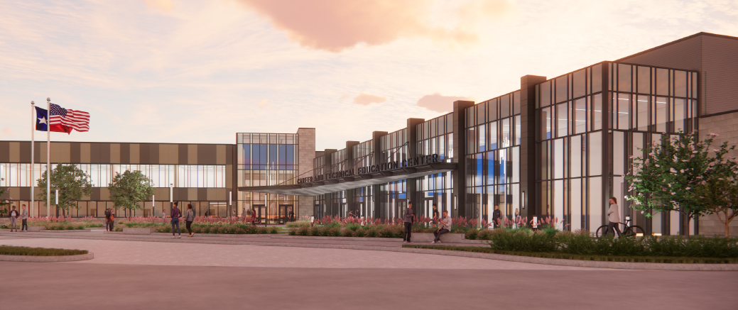
Coming August of 2026!
LCISD Career & Technical Education Center

Slide 8
What will be offered at the CTE Center?
Architecture & Construction
  Carpentry
  HVAC & Sheet Metal
  Plumbing & Pipefitting
  Electrical
AAVTC
  Graphic Design
  Digital Communications
Engineering
  Drones
  Robotics
Human Services
  Cosmetology
Health Science
  Dental
  Pharmacy
  Patient Care
Hospitality & Tourism
  Culinary Arts
Transportation, Distribution, & Logistics
  Automotive Technology
  Distribution & Logistics
  Paint & Body

Slide 9

Don’t miss out on the Course Carnival!

Slide 10
Contact Information
E-mail: cte@lcisd.org
CTE Office: (832)223-0128
Connect With Us!
Twitter: @LamarCISDCTE
Facebook: facebook.com/LamarCTE/

