Slide 1


Slide 2
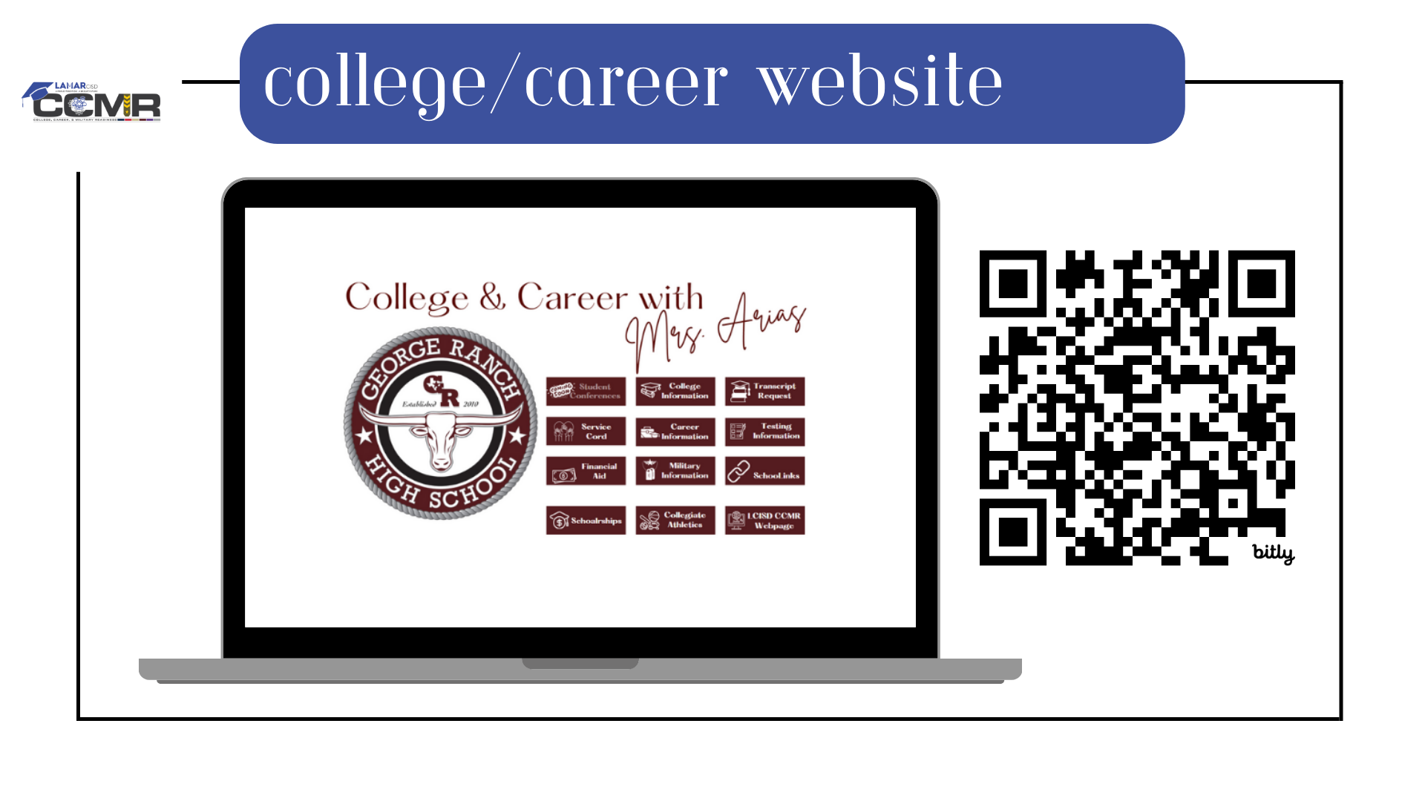

Slide 3
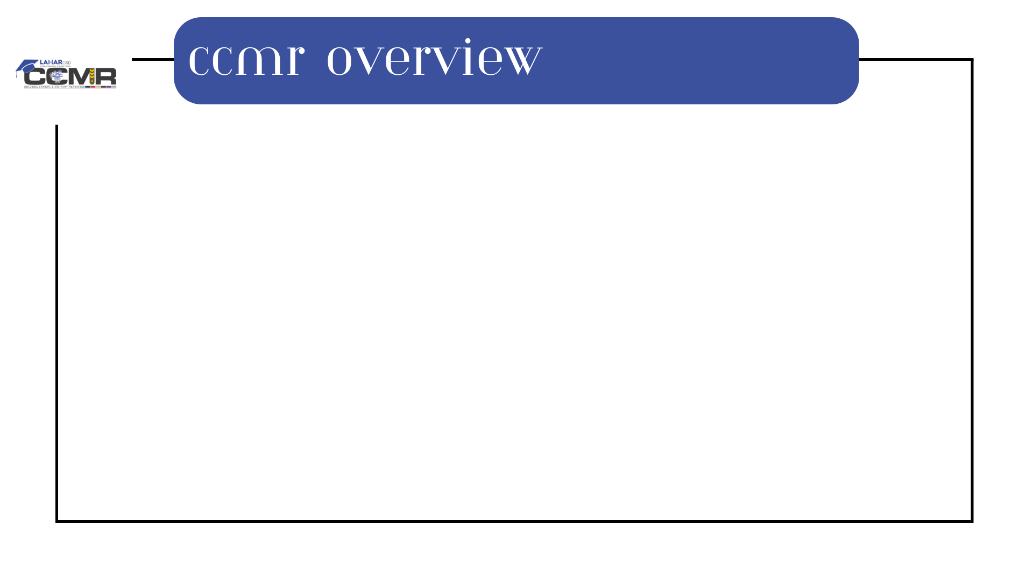
What is CCMR?
College Ready
A student who is college ready is prepared for any postsecondary goal without the need for college remediation. The student meets the minimum Texas Success Initiative scores through the SAT, ACT, or TSIA2, please see the scores that are required listed to the right to be exempt from remediation or developmental courses.
College remediation is when a student will need to enroll in additional developmental courses (English and Math) at a 2 or 4-year institution to prepare a student to complete standard college-level courses. These courses will not count towards the student's degree plan and must be taken prior to enrolling in standard college-level courses.
Career Ready
The student has completed or is working towards an industry certificate and has also met the TSIA2 benchmark through the SAT, ACT, or TSIA2.
Military Ready
The student has successfully completed the ASVAB exam and met the required score for a specific branch of the military. The student has completed and submitted enlistment documentation to the recruiter and high school.

Slide 4
College & Career Readiness Testing
Test | English Language Arts & Reading (ELAR) | Math
SAT | 480+ | 530+
ACT | Combined English & Writing Score: 40 | After Feb 2023: 22
TSIA2 | MC: 945 and Essay 5 OR MC: 910-944, Diag Level: 5-6, Essay 5-8 | MC: 950 OR MC 910-949, Diag Level: 6

Slide 5
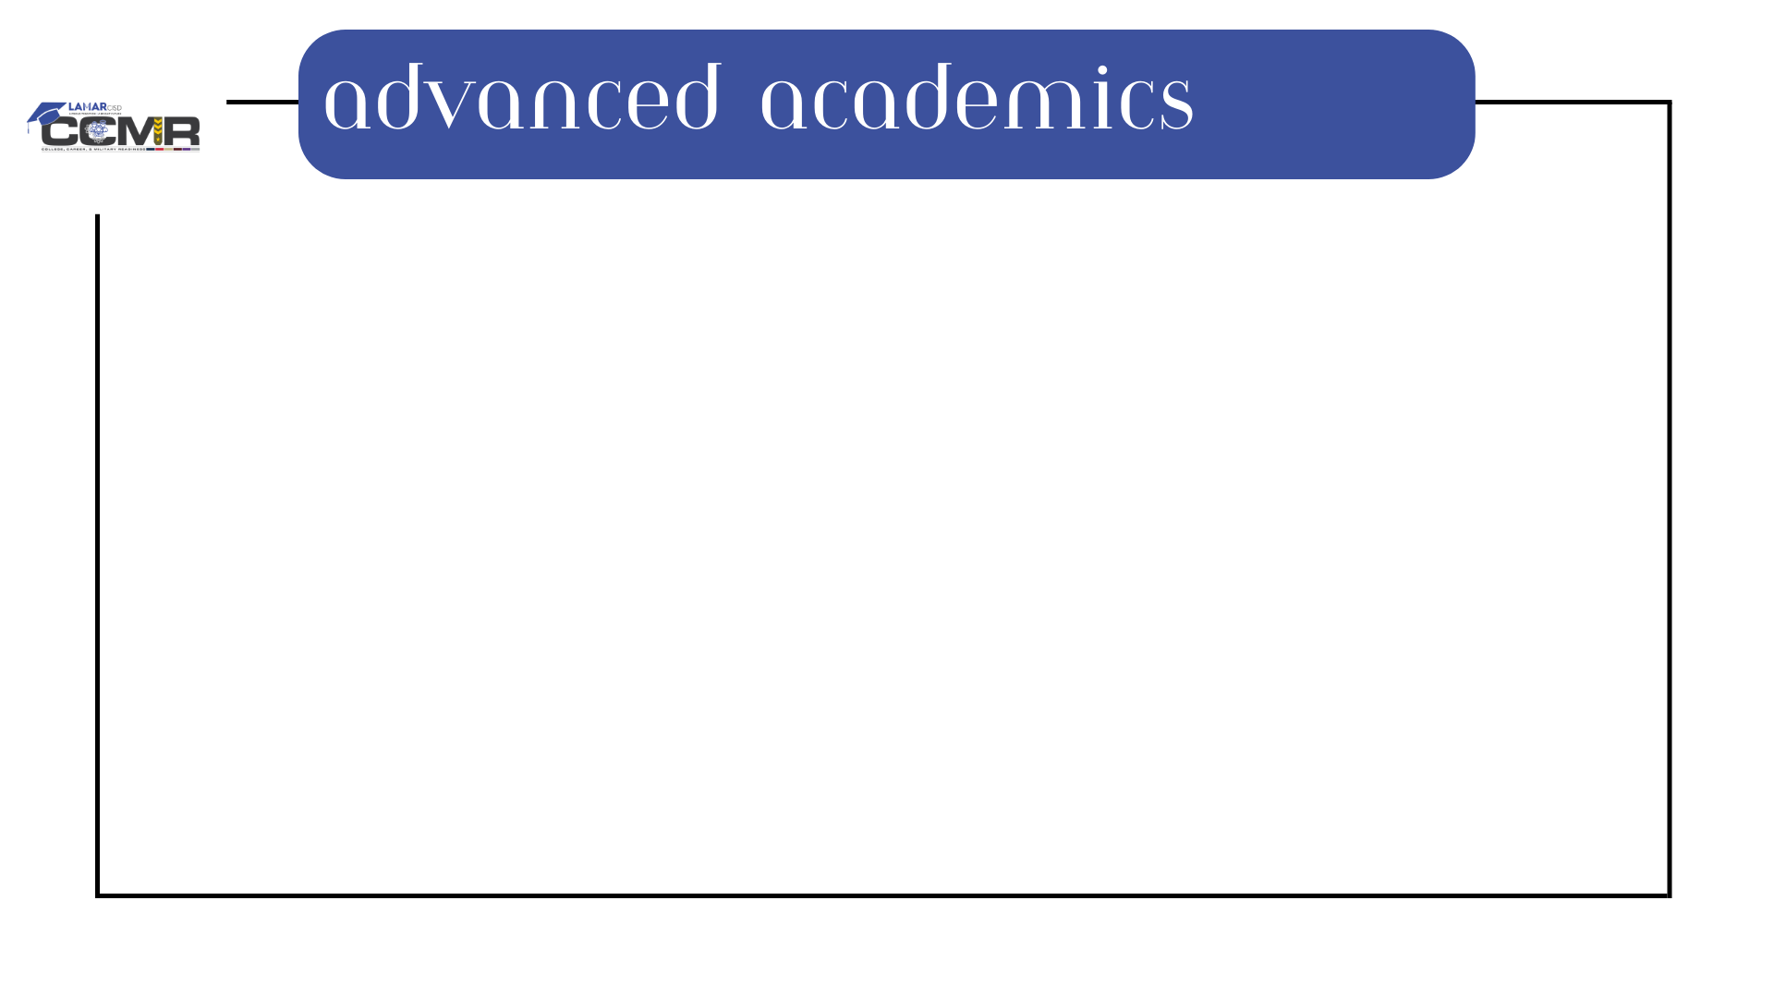
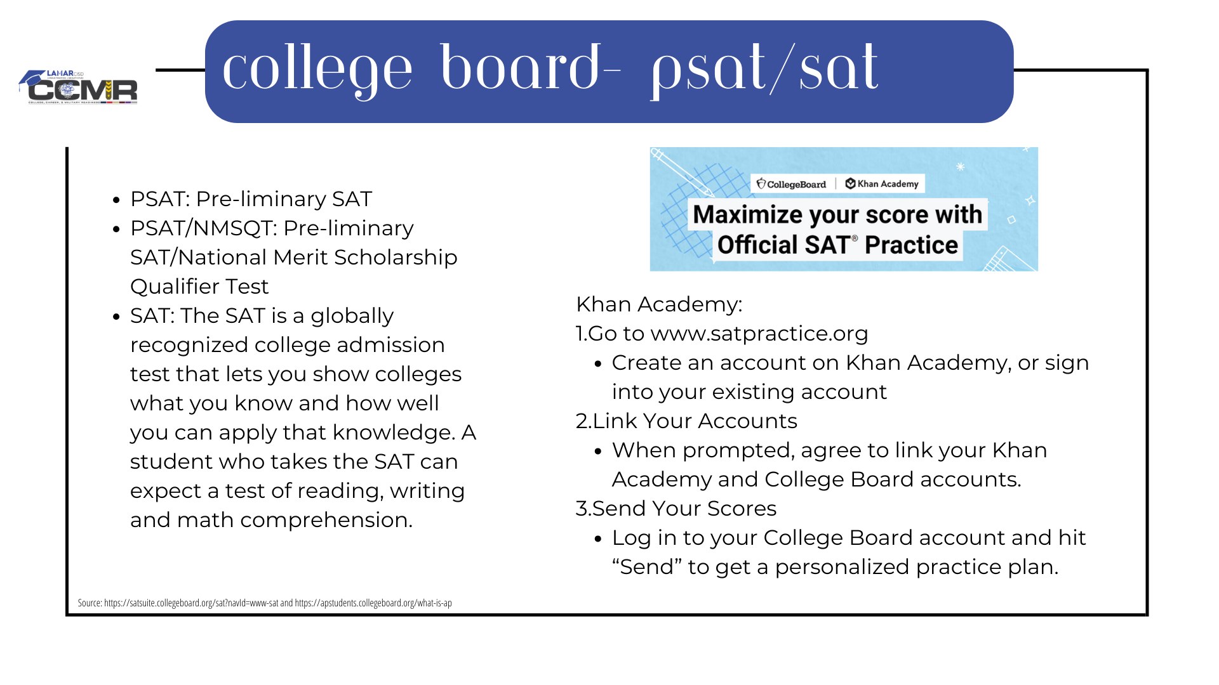
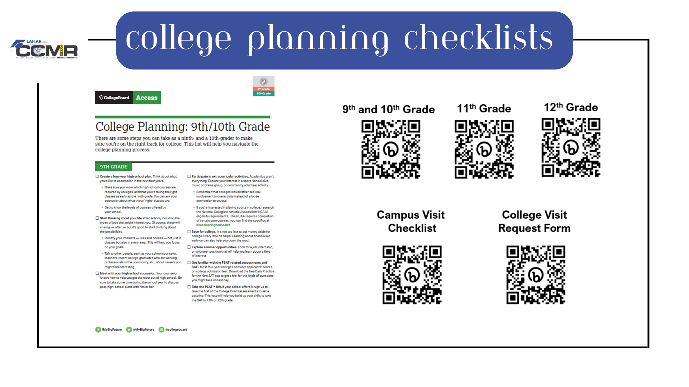
Advanced Placement: a weighted course designed by the College Board that will allow students the opportunity to earn college credit based on a score received on the course exam at the beginning of May. Students can begin taking AP courses their freshman year and do not need to meet specific qualifications, but some courses do have prerequisites.
Dual Credit: a partnership with Lone Star College that allows our students to be enrolled at both Foster HS and LSC to earn college credit for the specific weighted courses they are enrolled in. Students must qualify for Dual Credit classes by meeting certain college ready criteria. There are two gradebooks: one for Foster HS and one for LSC, the student must be passing in both to earn college credit at the end of the semester.
PAP: a weighted course that will help students prepare for the rigor of the college level courses listed above.

Slide 6
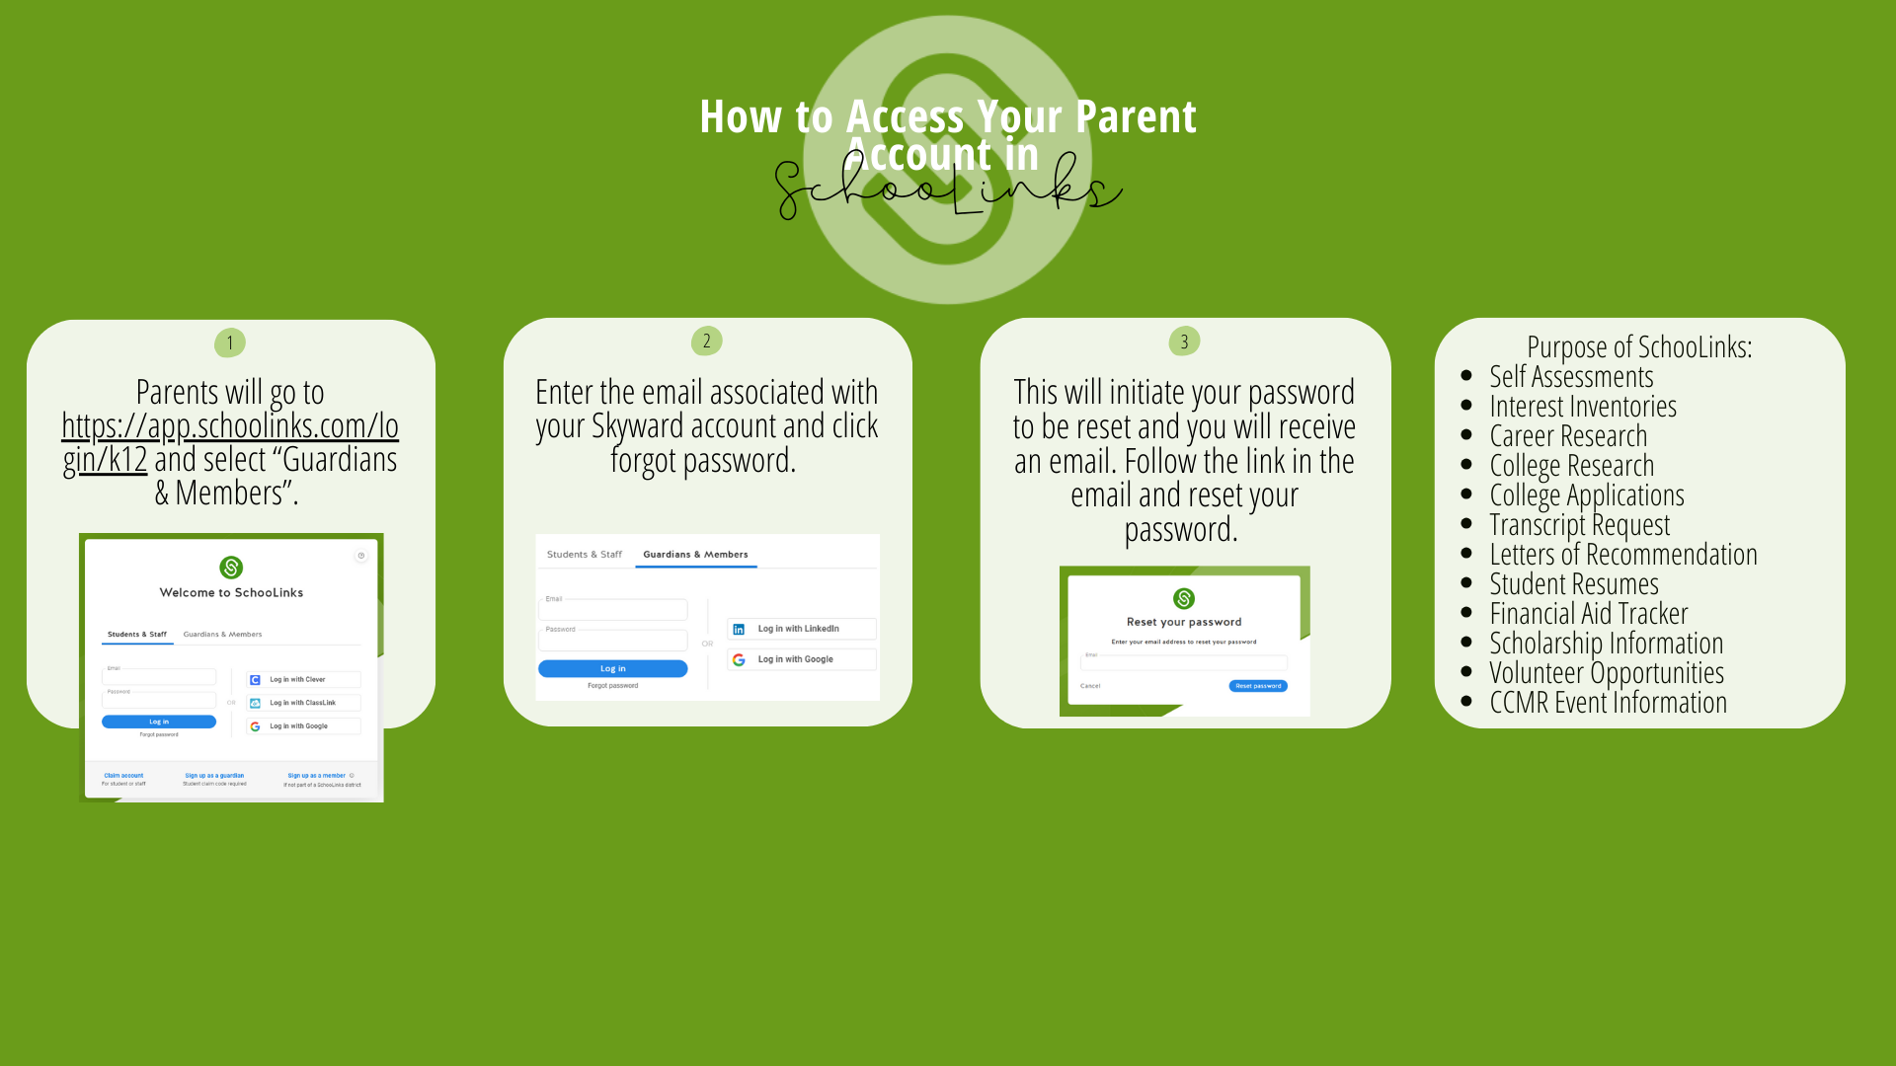

Slide 7
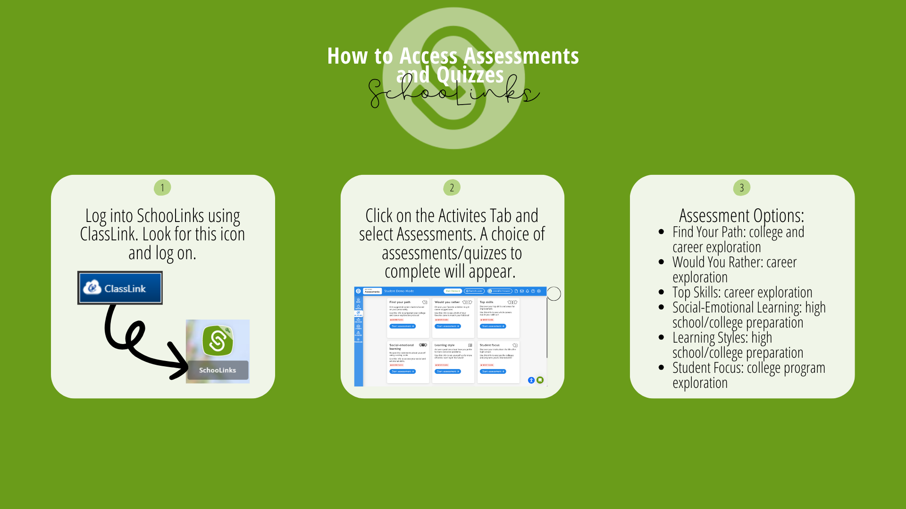

Slide 8
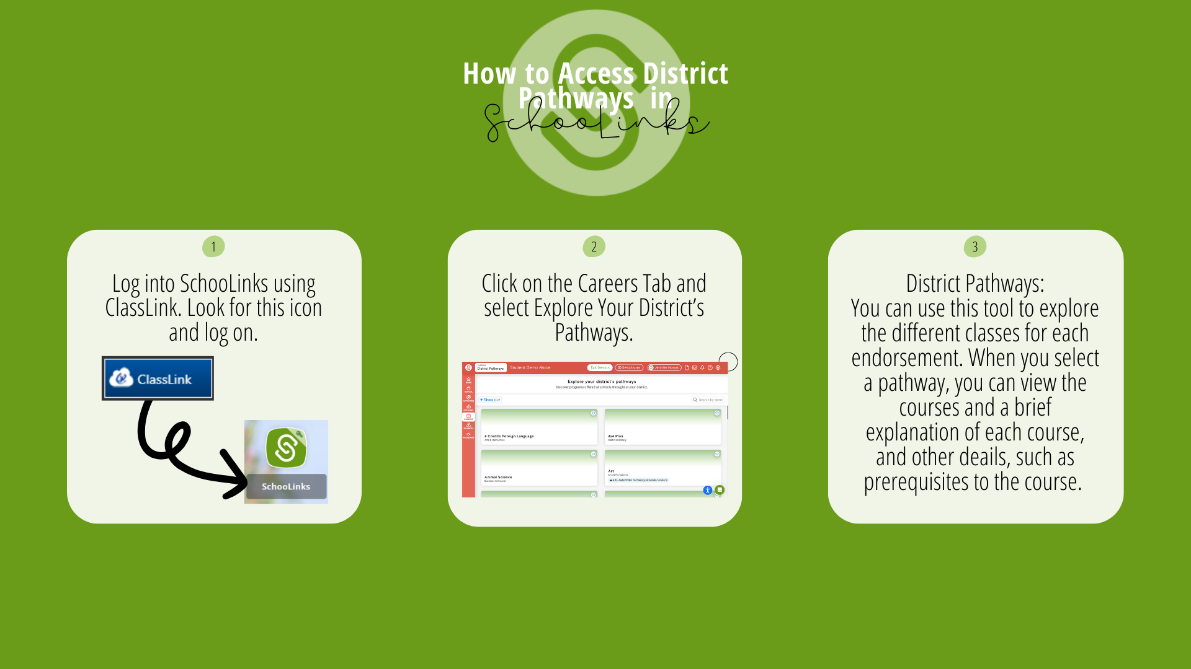

Slide 9


Slide 10

Students who earn 160 of district approved volunteer hours from a non-profit organization earn a white service cord to wear at graduation.
Students can start to accumulate these volunteer hours their freshman year and must earn the 160 hours by April 15 of their senior year.
Service Cord Guidelines are available on the district website, the CCMR website, the CCMR Newsletter, and the College & Career Canvas page.
Service Cord is not a graduation requirement.

Slide 11
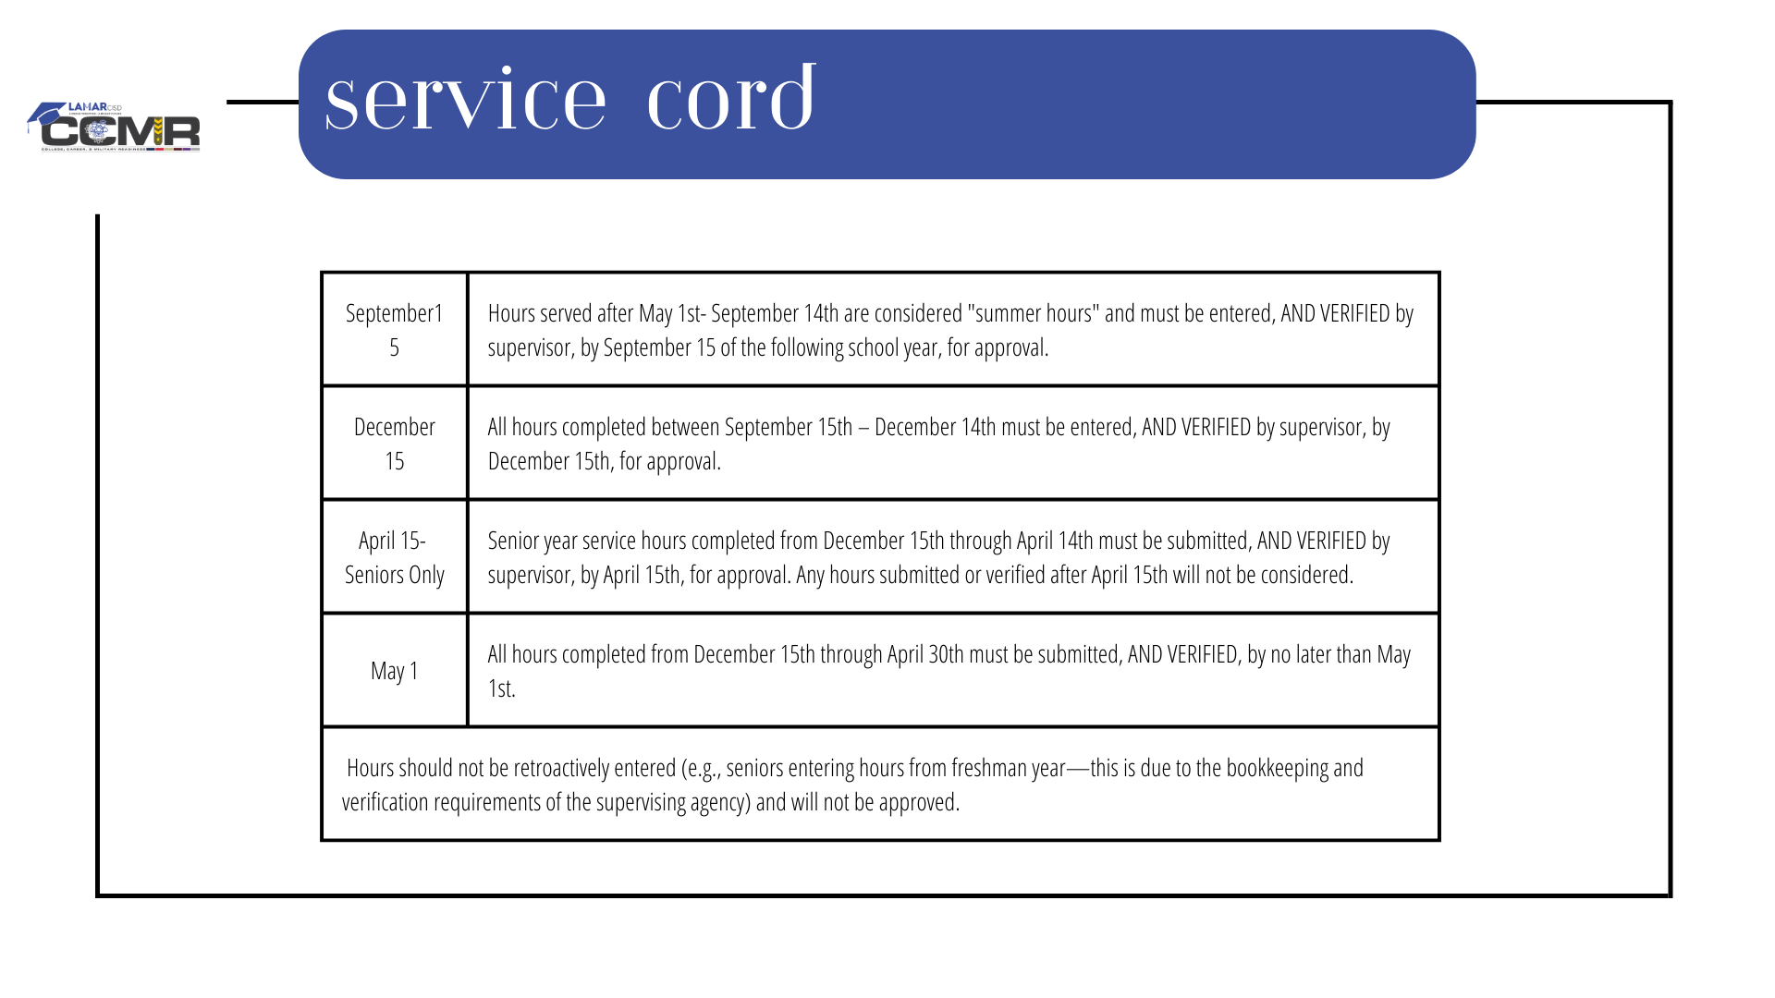

Slide 12
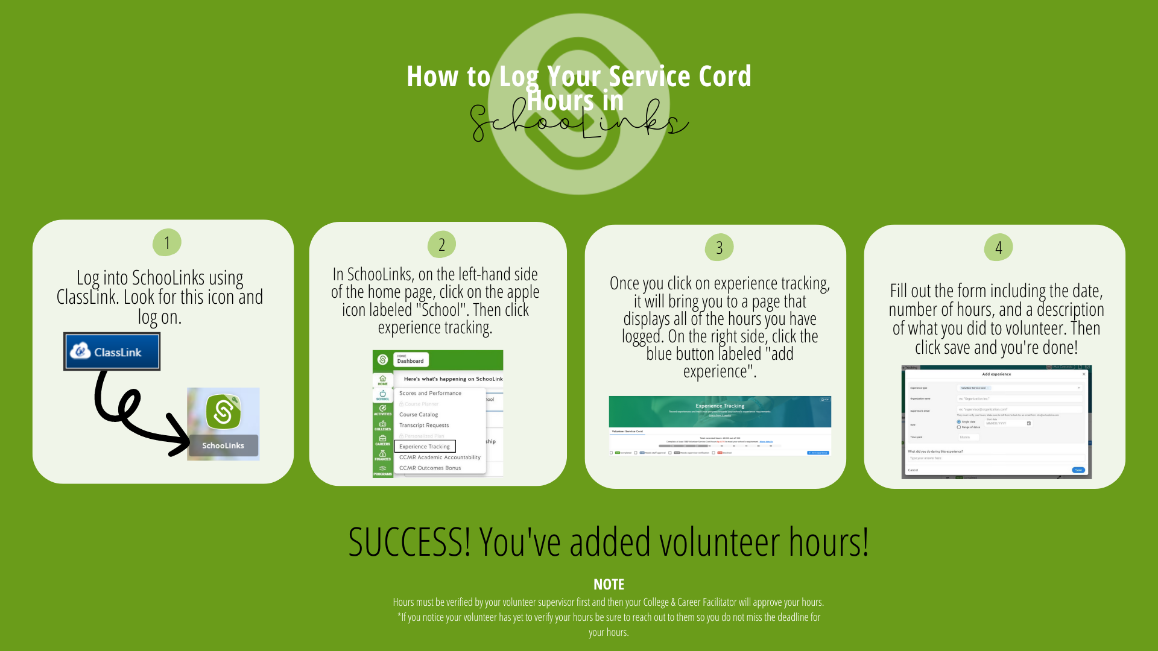

Slide 13
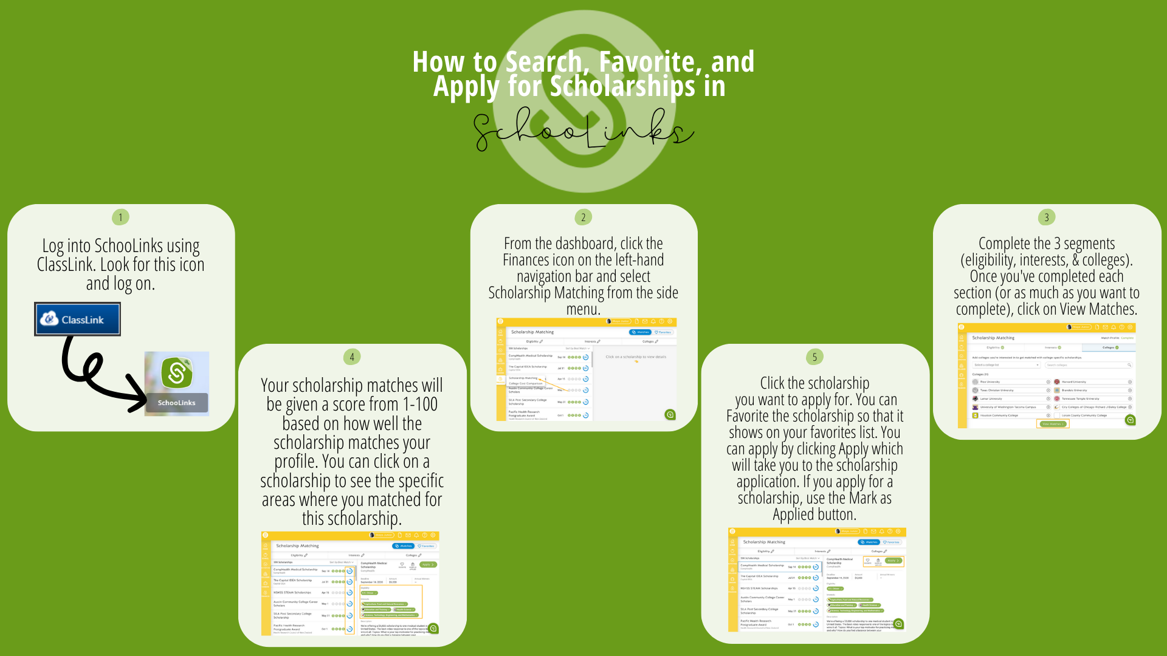

Slide 14
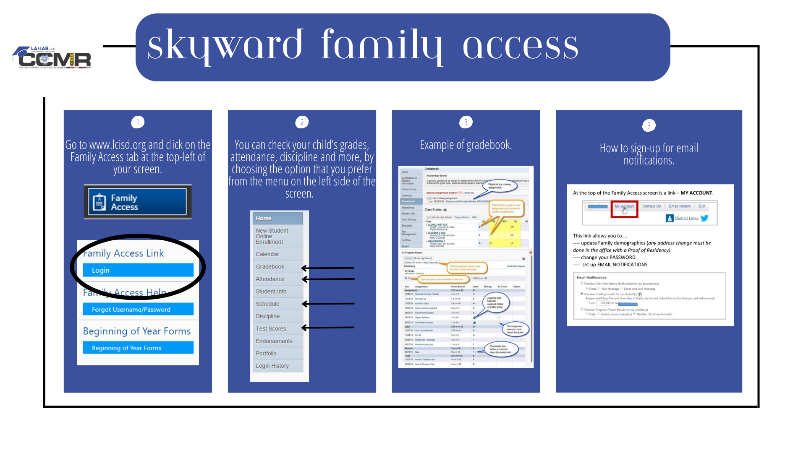

Slide 15
