Slide 1

Course Selection Night
Welcome to the 2025-2026 Course Selection Night

Slide 2

George Ranch Administration
Mrs. Patterson—Principal
MRs. Yanta—Associate Principal
Assistant principals:
Mr. Holmquist (A-EK)
MR. OJO (EL-LA)
Ms. Eilenstine (LE-P)
Mrs. coy (Q-Z)
Notes:
Add Admin info and pics

Slide 3
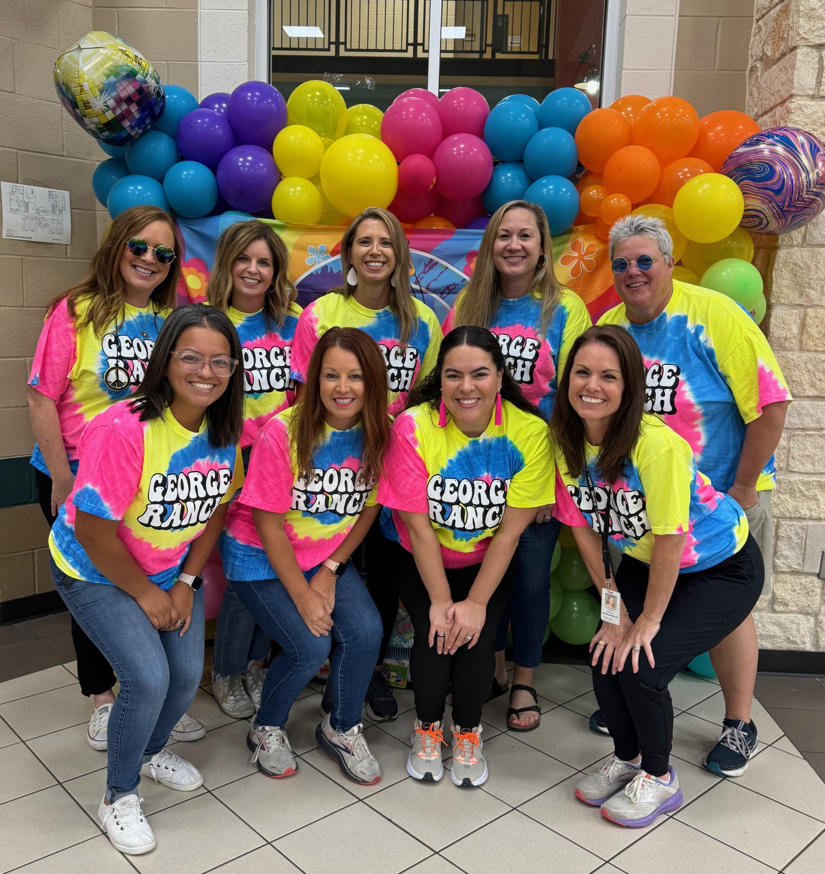
Counselors, Registrar, and CCF
Mrs. Ethridge (A-DAN)
Mrs. Richards (DAO-HOU)
Mrs. Ambrose (HOV-MOM)
Mrs. Pavlu (MON-SAC)
Mrs. Hunt (SAD-Z)
Mrs. Reeves (504 & AP Coordinator)
Mrs. Arias (College and Career Facilitator)
Mrs. Macha (Professional Registrar)
Notes:
Add Counselor and CCF Names, Alphas, pics., additional roles, etc.

Slide 4
Tonight’s Agenda
General Session:
  Course Selection Information
  Endorsements and Programs of Study Overview
  Advanced Academics Overview
  Career and College Planning Resources [SchooLinks] Intro
  Dismissal to Workshop Sessions
Wanting more information? Please attend this evening’s workshop sessions:
  Programs of Study and CTE: Auditorium
  Advanced Academics (Pre-AP, AP, OnRamps/Dual Credit): LGI
  College and Career Planning (College Board, Khan Academy, SchooLinks): Cafeteria
  Explore courses, contents, clubs, visit with counselors etc.: Hallways
Notes:
Add rooms and any additional sessions/topics as desired [by campus]

Slide 5
Course Selection

Slide 6
Course Selection Timeline
October 4-8: 8th graders choose their endorsement
October 7: Course Carnival for Maroon Track at Randle HS from 6-8 PM
October 9-11: Skyward window is open for current 8th graders to choose classes
October 9: GRHS Counselors will be at Reading JH to assist JH counselors with helping students enter classes into Skyward
October 15-October 31 at 5PM: Skyward window is opened for current 9th-11th graders. All students will enter their desired courses for the 2025-2026 school year into skyward. GRHS Counselors will be going into all Advisory classes to help and answer questions from students about course selection
The month of November high school counselors will complete course verification making sure students have the required number of courses and the prerequisites for the courses they chose. If students do not choose classes in Skyward, then classes will be chosen for them.

Slide 7
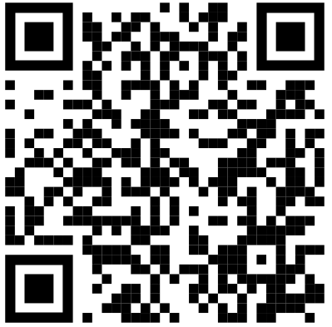
Career Plan/Skyward
The district Career Plan templates are intended to serve as a guide to families when planning for graduation. All courses except the required Endorsement course can be changed to accommodate academic level and interest.
The QR Code will take families to an informational step-by-step video on how to complete the process.
All choices will be verified and double checked by your child's counselor during the
course verification process to make sure they have the correct classes for that year.
We are here to help! This is a very exciting time and LCISD has some amazing options
for your student.
Informational Video:

Slide 8
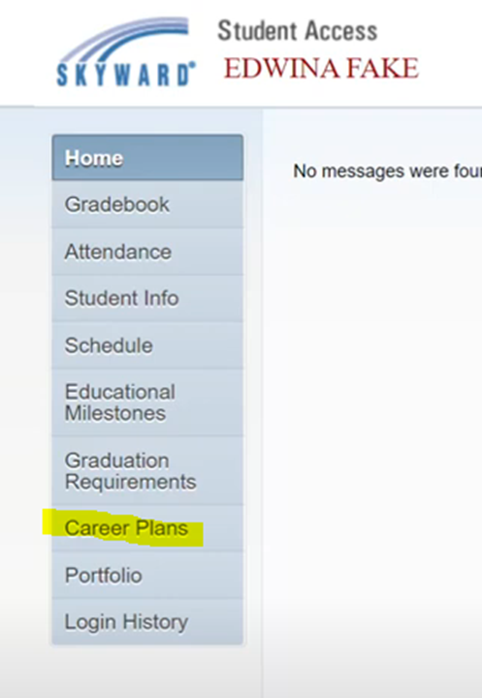


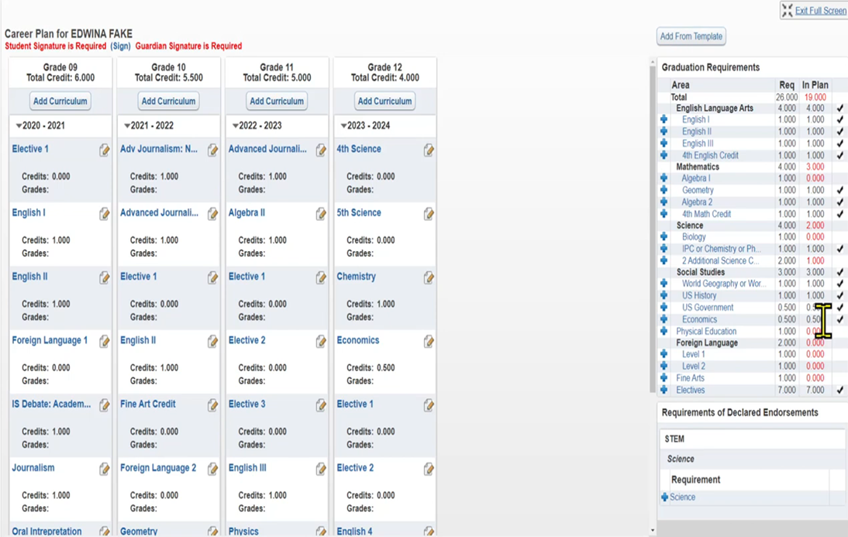

Slide 9
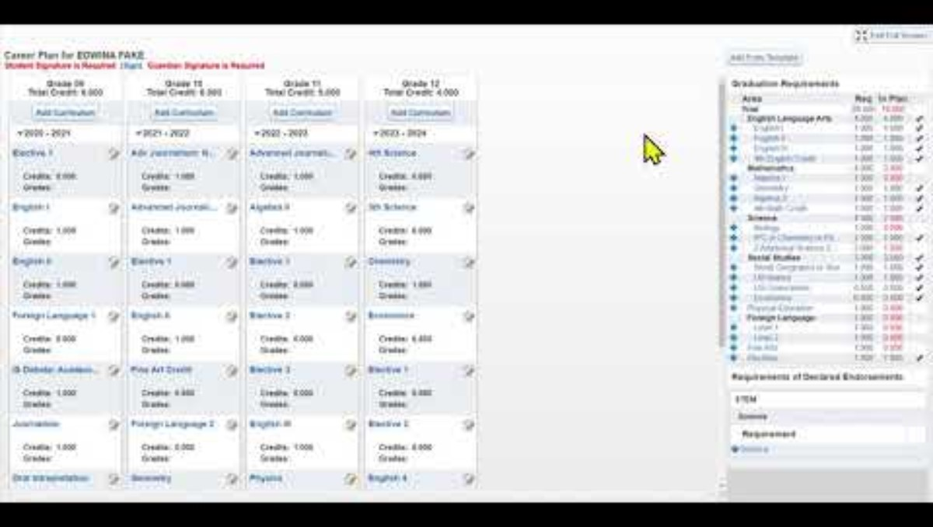

Slide 10
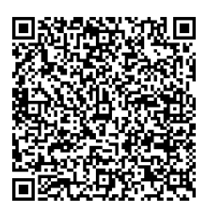
Course Catalog
The 2025-26 Course Catalog can be found on the lcisd.org website by clicking Students and Parents, then House Bill 5, and then 2025-2026 Course Catalog.
https://www.lcisd.org/docs/default-source/students-parents-documents/house-bill-5/downloads/25-26-course-catalog.pdf?sfvrsn=453af6e0_3
This important document has graduation requirements, GPA information, and all courses with descriptions and prerequisites

Slide 11
Endorsements and Programs of Study-CTE
Overview:
For Additional Information Please Attend Workshop Session on CTE Pathways in the Auditorium

Slide 12




LCISD
Programs of Study By Endorsement 2025-2026
Multidisciplinary
PUBLIC SERVICES
Arts & Humanities
Business &
Industry
Public Service
STEM
Multidisciplinary
Art
Agriculture, Food & Natural Resources:
Animal Science
or
Agricultural Technology & Mechanical Systems
Business, Marketing & Finance:
Business Management
or
Marketing & Sales
Human Services: Cosmetology and Personal Care Services
Engineering
Four credits in each of the four foundation subject areas to include English IV , Chemistry and/or Physics
Drones
(Unmanned Vehicle)
Band
Education & Training: Teaching & Training
Programming & Software Development - AP
Choir
Architecture & Construction: Carpentry
or
Plumbing & Pipefitting
or
Electrical
or
HVAC – Dual
Hospitality & Tourism: Culinary Arts
JROTC
Programming & Software Development: Cyber Security - Dual
Four Advanced courses that prepare students to enter workforce or postsecondary education without remediation from within 1 endorsement area or among endorsement areas that are not in a coherent sequence
Dance
Manufacturing: Welding - Dual
Health Science:
Diagnostics and Therapeutic Services
Programming & Software Development
English
Transportation, Distribution & Logistics: Automotive - Dual
or
Diesel & Heavy
Equipment – Dual
or
Automotive and Collision Repair
or
Distribution, Logistics, and Warehousing
Languages other than English
Robotics
Law & Public Service:
Law Enforcement
Science
Mariachi
Arts, Audio/ Video Technology & Communications:
Design & Multimedia Arts
or
Digital Communications
Mathematics
Four credits in AP or dual credit selected from English, math, science, social studies, economics, LOTE or fine arts
Orchestra
STEM:
Combination
(4 or more STEM courses + 3 additional electives)
Social Studies
Theatre
Business & Industry:
Combination
(4 or more B&I courses + 3 additional electives)

Slide 13
What does CTE offer to students?
Agriculture, Food, & Natural Resources
  Agricultural Technology & Mechanical Systems
  Animal Science
Architecture & Construction
  Carpentry
  HVAC & Sheet Metal (Dual Credit through TSTC)
AAVTC
  Graphic Design
  Digital Communications
Business, Marketing, & Finance
  Business Management
  Marketing & Sales
Education & Training
  Teaching & Training
Health Science
  Dental
  Pharmacy
  Patient Care
Hospitality & Tourism
  Culinary Arts
Law & Public Service
  Law Enforcement
Manufacturing
  Welding (Dual Credit through TSTC)
STEM
  Cybersecurity (Dual Credit through TSTC)
  Engineering
  Programming & Software Development
Transportation, Distribution, & Logistics
  Automotive Technology (Dual Credit through TSTC)
  Diesel & Heavy Equipment (Dual Credit through TSTC)
Notes:
Dual Credit Opportunities
Industry-Based Certifications
CTSOs (i.e., DECA, FFA, HOSA, SkillsUSA, TAFE, TSA)
National Technical Honor Society

Slide 14
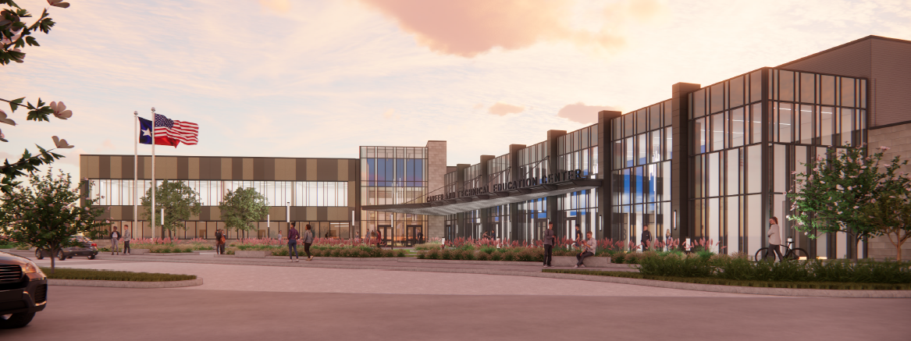
Coming August of 2026!
LCISD Career & Technical Education Center

Slide 15
What will be offered at the CTE Center?
Architecture & Construction
  Carpentry
  HVAC & Sheet Metal
  Plumbing & Pipefitting
  Electrical
AAVTC
  Graphic Design
  Digital Communications
Engineering
  Drones
  Robotics
Human Services
  Cosmetology
Health Science
  Dental
  Pharmacy
  Patient Care
Hospitality & Tourism
  Culinary Arts
Human Services
  Cosmetology
Transportation, Distribution, & Logistics
  Automotive Technology
  Distribution & Logistics
  Paint & Body

Slide 16
Advanced Academics
Overview:
For Additional Information Please Attend Workshop Session(s), directly after the General Session in the LGI.

Slide 17

Advanced Academics
Advanced Placement (AP)
1.3 Multiplier
College Credit based on exam score
HS gradebook only
Grades 9-12
Dual Credit and Dual Enrollment
1.3 Multiplier
College credit based upon college grade
HS and College Gradebooks
Grades 11-12
Pre-AP/PAP/Honors
1.2 Multiplier
No college credit
PreAP/Honors
Electives with a W at the end of the four-digit course code
*for campus specific course questions please visit the Counselor Corner during workshops

Slide 18
Join us in workshops for additional information.
Dual Credit and Advanced Academics (AP, Pre-AP) will be answering question and going over information in the LGI.
Notes:
Add Workshop Room Numbers

Slide 19

College and Career Planning Resources:
For Additional Information Please See College and Career, directly after the General Session in the Cafeteria

Slide 20

SchooLinks
•LCISD’s College and Career Exploration Tool for grades 6-12
•It is a modern College & Career Readiness platform with over 80 experiences such as career interest inventory assessments, college and career search, internship matching, portfolio, scholarships and more
•This can be accessed through the student’s Class Link account.
College and Career Readiness Platform

Slide 21
Need Additional College and Career Readiness Information?
Presentation on College and Career: Cafeteria
Information on SchooLinks, College Applications, Khan Academy and College Board, and much more.

Slide 22
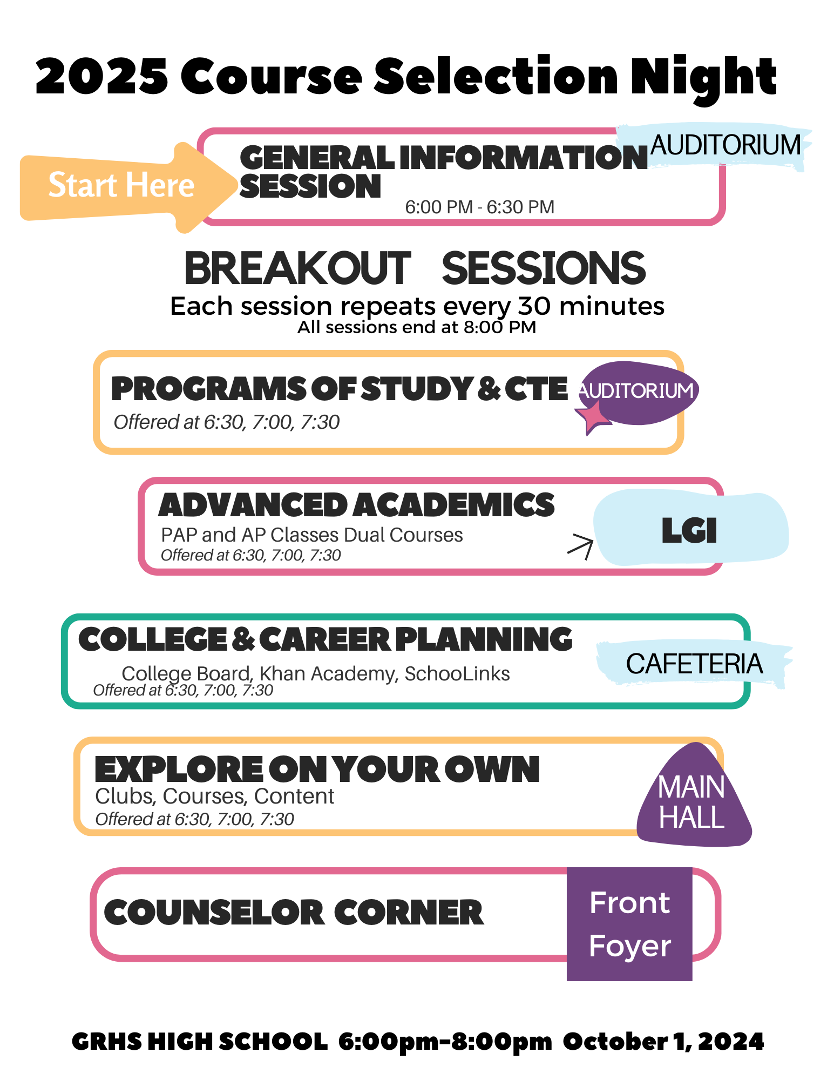
Schedule of Rotations
There are multiple sessions you can attend.
If the session is full, please choose another for the time being. You can circle back if needed.

